Slide 1
3. 词汇妥帖，语法无误，格式正确，高分作文必作于细成于严
常见地点的表达
学校：
礼堂 auditorium /ˌɔːdɪˈtɔːriəm/ ; lecture hall
体育馆 stadium /ˈsteɪdiəm/ ; gymnasium /dʒɪmˈneɪziəm/
国际交流中心 the International Exchange Center
科技馆 the Science Museum
教学楼3楼301室 Room 301 in the Teaching Building
社会：
敬老院 the nursing home
画廊 gallery /ˈɡæləri/
博物馆 museum
学校：
礼堂 auditorium /ˌɔːdɪˈtɔːriəm/ ; lecture hall
体育馆 stadium /ˈsteɪdiəm/ ; gymnasium /dʒɪmˈneɪziəm/
国际交流中心 the International Exchange Center
科技馆 the Science Museum
教学楼3楼301室 Room 301 in the Teaching Building
社会：
敬老院 the nursing home
画廊 gallery /ˈɡæləri/
博物馆 museum

Slide 2
3. 词汇妥帖，语法无误，格式正确，高分作文必作于细成于严
活动反响
假定你是李华, 上周日你校举办了5公里越野赛跑活动。请你为校英文报写一篇报道, 内容包括:1. 参加人员；2. 跑步路线:从校门口到南山脚下；3. 活动反响。（2020年7月新高考全国卷Ⅰ--山东卷 应用文）
① The magnificent scenes along the route erased our anxiety/ agitation _{/ˌædʒɪˈteɪʃn/ 焦虑不安；忧虑；烦乱} for the approaching College Entrance Examination and brought us enormous delight/gaiety _{/ˈɡeɪəti/快乐} .
沿途的壮丽景色抹去了我们对即将到来的高考的焦虑不安，给我们带来了巨大的快乐。
② We exposed and explored ourselves to splendid nature, which erased our tiredness/ fatigue _{/fəˈtiːɡ/ n. 疲劳，疲乏} and pressure caused by heavy study.
我们将置身于在美丽的大自然中，这消除了我们繁重的学习带来的疲劳和压力。
③ The race was of great benefit to the participants, physically and mentally. Therefore, we all think highly of it, and expect more activities like this in the future.
赛跑对参赛者的身体和精神都有很大好处。因此，我们都盛赞并期待在未来有更多这样的活动。

Slide 3
3. 词汇妥帖，语法无误，格式正确，高分作文必作于细成于严
④Challenging as the activity was让步倒装, everyone enjoyed it and all the participants benefited a lot from it.（总）
虽然活动很有挑战性，但每个人都很享受，所有参与者都从中受益。
⑤ Aimed to fight against pollution while enjoying the great outdoors,the Cross-Country Eco-Race Carry is designed to pick up food packaging and other such trash while running, and contribute to environmental protection along the route! （细）
旨在与污染作斗争的同时，享受美好的户外，越野生态背包跑 捡起食品包装等垃圾，并为沿途的环境保护做贡献!
⑥ This activity emphasized students’ overall development, especially in physical health and mental endurance . It also boosted morale _{/məˈrɑːl/ n. 斗志} of the teaching staff, awaking them to the importance of regular workout. （细）
这项活动强调学生的全面发展，特别是在身体健康和心理耐力方面。它还提高了教师的士气，使他们意识到定期锻炼的重要性。

Slide 4
3. 词汇妥帖，语法无误，格式正确，高分作文必作于细成于严
活动反响
假定你是李华, 上周日你校举办了5公里越野赛跑活动。请你为校英文报写一篇报道, 内容包括:1. 参加人员；2. 跑步路线:从校门口到南山脚下；3. 活动反响。（2020年7月新高考全国卷Ⅰ--山东卷 应用文）
⑦ By immersing everyone in the charm of nature, this activity definitely offers relaxation to us. Not only can it strengthen our perseverance, but it enhances our friendship.
让每个人都沉浸在大自然的魅力中，这个活动无疑给我们带来了放松。它不仅能加强我们的毅力，也能增进我们的友谊。
⑧ After the event, we felt that not only did the event improve our physical and psychological quality, but it also helped us build a positive attitude towards life. We do hope that the school will carry out more similar activities in the future.
活动结束后，我们感到这次活动不仅提高了我们的身体和心理素质，还帮助我们树立了积极的生活态度。我们希望学校今后能开展更多类似的活动。

Slide 5

跨文化沟通能力，
传播中华文化的能力
让考试插上腾飞的翅膀
高考方向和预测

Slide 6
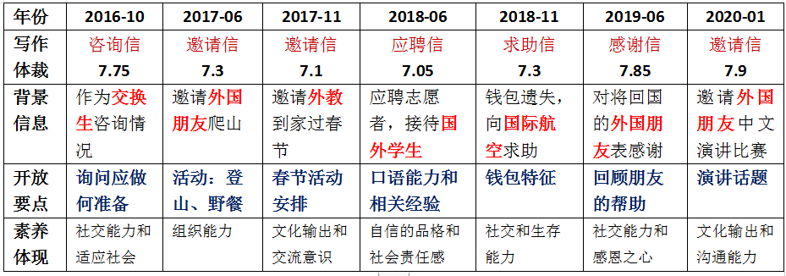
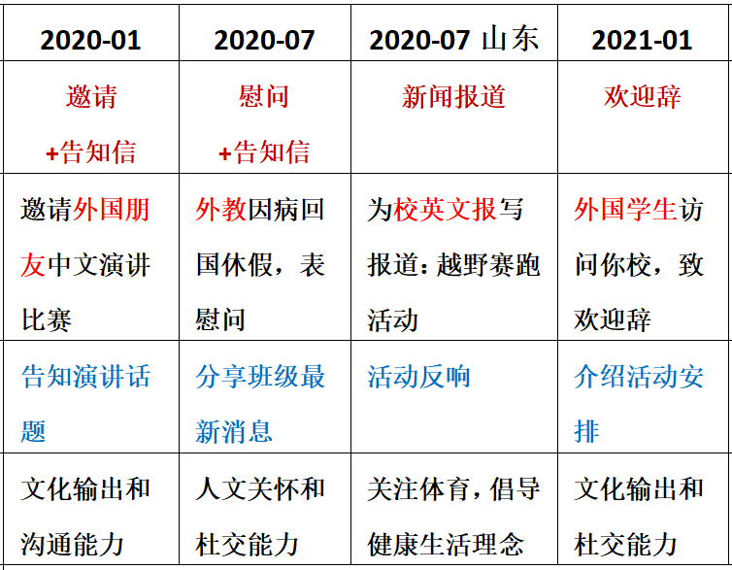
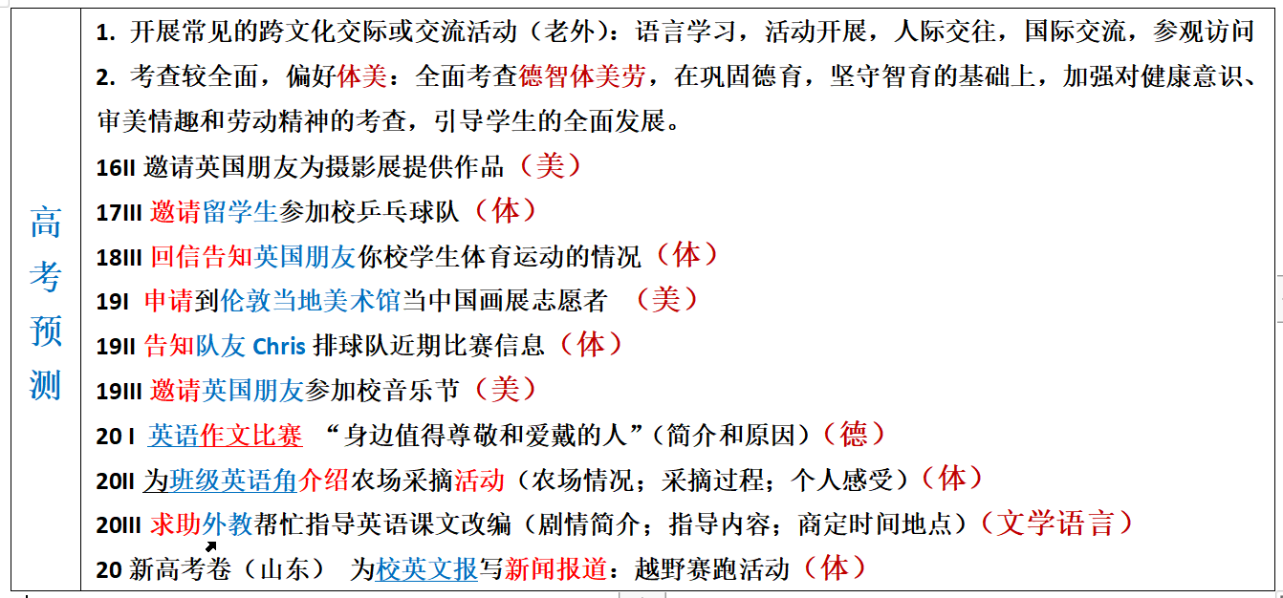
4. 高考方向和预测 —— 偏好体美，全面考查德智体美劳
体
体

Slide 7

德智体美劳; 招聘志愿者; 通知告示；国际视野家国情怀
（2021届江苏省如皋市高三上学期第三次月考英语试题） 如皋国际马拉松赛将于2021年3月举办，请你代表如皋马拉松协会写一封80字的告示，招募志愿者。告示需包括:
1.申请者所应具备的基本素养; 2.你认为的有关信息。
Notice
_______________________________________________________________
Rugao Marathon Association
Notice
Volunteers are needed for Rugao Marathon to be held in March 2021. Basic requirements are familiarity with race course and proficiency in English. Other requirements include good interpersonal communication abilities, familiarity with our city’s tourist attractions and its history, proper manners, and a strong sense of responsibility. Preference will be given to those experienced in similar activities.
Call87654321 or email www.rugao marathon.com for application and for information on the interview. Phone and email enquiries are encouraged; no visits please.
Rugao Marathon Association

Slide 8
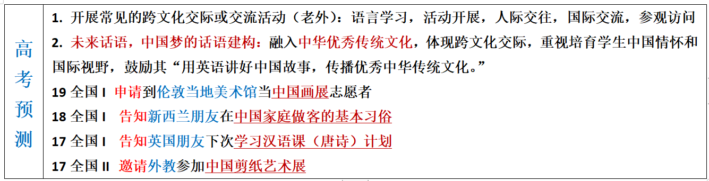
4. 高考方向和预测 —— 未来话语，中国梦的话语建构
文体活动
文化活动
文化活动
文化活动
回避政治敏感话题；
促进中外文化交流
时事要事中国梦

Slide 9
文化学习；国际视野；文化输出
假定你是李华，经常帮助你学习英语的朋友Alex即将返回自己的国家。请给他写一封邮件，内容包括：1. 表示感谢；2. 回顾Alex对你的帮助；3. 临别祝愿。（2019年6月浙江高考——感谢信）
Dear Alex,
Hearing your departure, I’m writing to express my sincere gratitude for your generous help.
Last year has witnessed my harvest in English. When I was messed up with all the language obstacles, It was your patience and guidance that enlightened me. Besides you always offered to revise the language style of my writing practice, which enabled me to savor a dip of authentic English. With cross-cultural notions and visions being exchanging, my knowledge scope was enriched and our friendship has been flourishing!
Attached to the letter is an auspicious Chinese knot. May every moment full of joy on your new stage of life!
Yours genuinely,
Li Hu
be messed up with（糟糕面对）； enlighten（启发；教导）；
savor a dip of（品尝，欣赏）； authentic（真正的，真实的）；
notion and vision（概念与视野）； scope （ /skəʊp/ 视野；眼界）；
flourish (/ˈflʌrɪʃ/ v.茂盛；茁壮成长) ; auspicious（ /ɔːˈspɪʃəs/ 吉祥的）

Slide 10
文化交流；国际视野；文化输出
（2021年1月浙江高考——致欢迎辞）
假如你是李华，下周新西兰学生访问你校，你将作为学生代表致欢迎辞。请为此写一篇发言稿，内容包括：1.表示欢迎；2.介绍活动安排；3.表达祝愿。
During your visit, we will do a lot of interesting things together, including watching kungfu, visiting a tea museum, learning ink painting, and trying different kinds of Chinese food. We will also take you to an ancient town, where you will learn about the local culture. Finally, we really look forward to interacting with you and wish you a good time here! 范文
After the welcome meeting, we will show you around the school so that you can be more familiar with it. Then you will attend a Chinese class where you can savour a dip of the beauty of Chinese. At noon, you can enjoy some traditional Chinese delicacies. The following hours you will experience paper cutting, exploring the magic of Chinese art.

Slide 11
文化交流；建议信件；文化输出
（2018年 10月稽阳联考）假定你是李华，你的英国朋友Peter来信就下周三要参加孔子学院(the Confucius Institute)的面试征询你的意见。请你写封回信，内容包括： 1. 写信目的；2. 提出建议；3. 表示祝愿。
1. Because you are good at Kung fu / cross-talk/ calligraphy/ Beijing Opera/ Chinese Classics Recitation, it is more advisable to demonstrate your specialty on the spot, leaving the judges a deep impression.
1. 因为你擅长中国武术/ 相声/书法/京剧/中华经典文学朗诵，你可以现场表演, 给评委留下深刻印象。
2. Since you take a great fancy to Chinese culture, especially the Dragon Boat Festival/ Chinese tea culture/ traditional Chinese medicine, it would also be a novel idea if you could introduce what you know to the interviewers.
2. 因为你很喜欢中国文化，尤其是端午节/中国茶文化/中医，如果你能把你知道的介绍给面试官，这也是一个新奇的想法。
3. Having visited China many times, you can introduce the cultural attractions and local landmarks of China to the judges, showing your love for China.
3. 既然你多次来中国旅游，你可以向评委介绍中国的人文景点，表明你对中国的喜爱。

Slide 12
文化交流；建议信件；文化输出
（2018年 10月稽阳联考）假定你是李华，你的英国朋友Peter来信就下周三要参加孔子学院(the Confucius Institute)的面试征询你的意见。请你写封回信，内容包括： 1. 写信目的；2. 提出建议；3. 表示祝愿。
Dear Peter,
Glad to receive your letter asking me for some advice on the interview for the Confucius Institute scheduled for this coming Wednesday. I’m writing to remind you of what to prepare for.
It would be wise of you to read some books about Confucius, which helps to better understand traditional Chinese cultures. It would also be beneficial to learn a few Chinese greetings. Additionally, Wearing Han-style clothing will make you stand out among the candidates and impress the interviewers greatly.
I do hope my proposal could be practical. Wish you good luck!
Yours Sincerely,
Li Hua

Slide 13
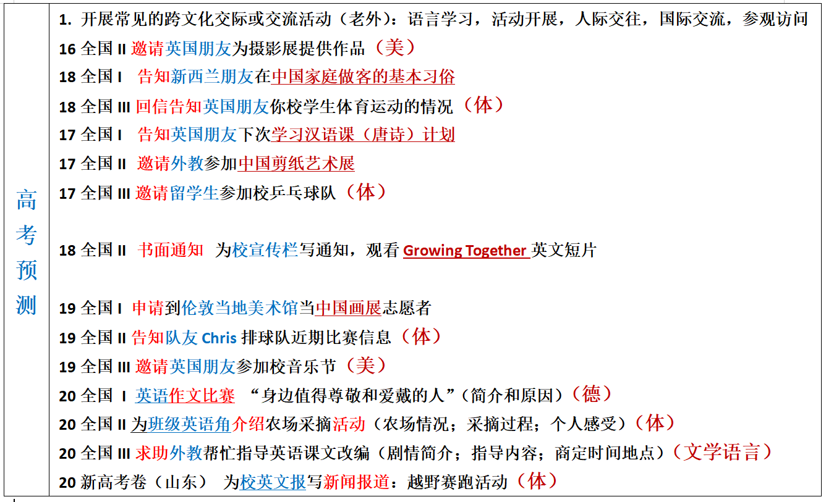
4. 高考方向和预测 —— 体裁（有形式但重意义的传达）
非书信
1.邀请信和告知信备受命题者喜爱
2.五年内未考：
建议信；道歉信；祝贺信；
通知；
发言稿_{（演讲？，欢迎，欢送）}
投诉信？

Slide 14
建议信件；文化输出; 文化学习
（2020学年第二学期五校联考试题 学军中学）假定你是李华，你的新西兰朋友Leo准备来中国学习，他来信向你咨询有关学习汉语的建议。请用英语给他写一封回信。内容包括：1. 表示欢迎；2. 提出建议； 3. 表达期望。
Dear Leo,
Delighted to know that you are coming to study in China, I am writing this to discuss with you on how to learn Chinese.
First, it’s essential to enlarge your vocabulary to overcome your reading difficulties. You should also take any opportunity to communicate in Chinese. Plus, getting to know the culture and history of China will help you learn Chinese better and increase your interest in learning this language.
I hope my suggestions are helpful to you and feel free to drop me a line if you have any other questions.
Yours,
Li Hua

Slide 15
第一节 应用文（满分15分）
假定你是李华，你的新西兰朋友Leo 准备来中国学习，他来信向你咨询有关学习汉语的建议。
请用英语给他写一封回信。内容包括：
1.表示欢迎；
2.提出建议
3.表达期望。
注意：1.词数80左右；
2.可以适当增加细节，以使行文连贯。

Slide 16
Para1(background and writing purpose)
1.Glad to hear your plan to study in China, I’m more than delighted to anticipate your arrival and obliged to offer my personal advice for your Chinese learning as well.
... Cordially anticipating your arrival and steady progress(Ma)
修：1.Glad to hear your plan to study in China, I’ anticipating your arrival and more than delighted to offer/share my personal advice for your Chinese learning as well. ...Cordially anticipating our meeting soon and your steady progress.
2.I’m thrilled to hear your plan to study in China and could hardly wait to meet you. As for the way to learn Chinese wel, my proposals are as follows. (Fan)

Slide 17
Advice:
1.充分接触汉语，如每天收听广播，也是一种有效的方法，因为听力对学习一门语言至关重要。
Full exposure to Chinese, such as listening on the radio daily, is also an effective way as listening is of vital importance to learn a languange.
2.尽可能多地和中国人交流是我的建议之一，这不仅可以练习你的汉语口语，还可以让你在对话中品味地道的汉语。
Communicating as much as possible with the native comes top of my advice, which not only practises your spoken Chinese, but also allows you to savor a dip of authentic Chinese /embrace authentic Chinese during conversations.

Slide 18

FIGHTING

